Slide 1
Lego case assignment
System overview
Bulk to conveyor
Single line bricks
Size sorting
Weighting and image collection
Data Analysis => Brick id
Sorting to sets

Slide 2
Bulk to conveyor
Single line bricks
PLC
Vision system
Pick and place
Database
Seamless integration between different components:
This is done to track the single brick
The PLC should be the master which triggers the cameras
The vision system then simply reports to the PLC what the classification is
The PLC will also be in charge of updating the database and the running sets as described later on.
Some of the communication could be using snap7. Some directly in the db

Slide 3
Bulk to conveyor
Single line bricks
Size sorting
Weighting and image collection
Data Analysis => Brick id
Sorting to sets
Engineering practices:
It is a prototype: Fail quickly
Agile: Tests
Modulate: One thing at a time
What could go wrong:
False classifications
Image db
Final validation
Mech. issues (bricks stuck):
Quick prototypes –quick fails
System to big or inflexible:
Updates to the stakeholders.
Issues from the operators
Communication: no lost income
Ensure success:
Close collaboration with stakeholders
The engineering practices

Slide 4
Size sorting
Weighting and image collection
Data Analysis => Brick id
ML/image recognition: Priorities.
If the bricks should be size and/or color sorted into a number of categories
CI: continues buildup of the image dataset.
This will make it simpler to categorize with a series of different CNN each specializing in that size/color
The shape of the brick could be added with a 2D laser line on the belt.
As added info each brick could also be weighed.
It could be necessary to get a second images after a flipping of the brick.
If neither images are conclusive the brick would end up in the rerun bucket.
All images should be saved with prod_id possible in the cloud or on a sperate NAS

Slide 5
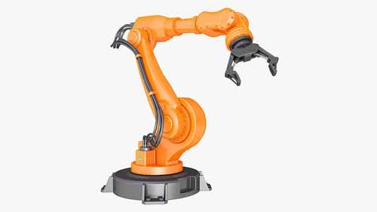
Sorting to sets
Set_id =251
Set_id =211
Set_id =251
Set_id =2
Set_id =42
Rerun/
man. sort
Every station has its own robot/bucket and its own running set that it is working on
If a brick comes by that is not yet in the set but is needed the bucket will turn
The running set will then be updated.
Once a set is complete a picture will be taken of the set. This could work as a validation.
A complete set will then be packed and a new set will be started at the station.
At the end all the bricks which does not fit a running set will end up.
There should be at least twice as many stations as different sets if we expect all to be sorted.

Slide 6
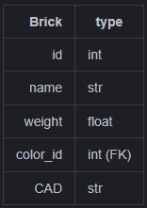
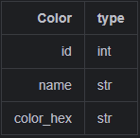
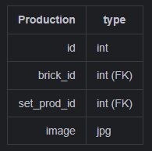
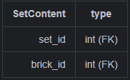
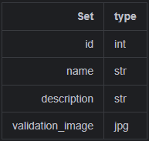
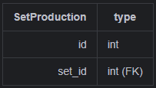
Databases
All tables should also have:
created
updated
version
And perhaps: in_production

